Slide 1
Public Vs Private Banks
Project 3
Group 6
Subject: Economics

Slide 2
Group Members
Maunil Vyas 1401007
Deep Patel 1401010
Shreyas Patel 1401025
Jay Dangar 1401043
Pratham Solanki 1401049
Ashutosh Kakadiya 1401075
Deep Talati 1401085
Harsh Mehta 1401086
Kishan Raval 1401117

Slide 3
Introduction
“A bank includes a body of persons, whether incorporated or not, who carry on the business of banking”
“Bank is an institution, which deals in money and credit”
Process of Profit:
Takes back money higher than the cost of the money they lend
Collects interest on loans and interest payments from the debt securities they own, and pay interest on deposits, FDs, and short-term borrowings.

Slide 4
Banking history in India
First Banks:
Bank of Hindustan (1770-1829)
The General Bank of India, estd. 1786.
SBI: Largest and oldest in India, estd. 1806
Reserve Bank of India: Country’s national banking institution estd. 1935

Slide 5








Public Sector Banks

Slide 6
Public Sector Banks
Major stack is held by the government (more than 50%)
27 Public Sector Banks in India
19 Nationalized Banks
6 State Bank Groups (SBI + 5 Associates)
IDBI
BMB (Bharatiya Mahila Bank)

Slide 7
Emergence of Public Sector Banks in India
Nationalization is the process of transforming private assets into public assets by bringing them under the public ownership of a national government or state. Nationalization usually refers to private assets or assets owned by lower levels of government, such as municipalities, being transferred to the state.
The main reason behind this is the nationalization process

Slide 8
Nationalization in 1969 By Govt. of India
After independence the Govt. of India adopted planned economic development for the country (India). Accordingly, five year plans came into existence since 1951. This economic planning basically aimed at social ownership of the means of production. However, commercial banks were in the private sector those days. In 1950-51 there were 430 commercial banks. The Government of India had some social objectives of planning. These commercial banks failed helping the government in attaining these objectives. Thus, the government decided to nationalize 14 major commercial banks on 19th July, 1969.
The Other Reasons were:-
To break the ownership and control of banks by a few business families,
To prevent the concentration of wealth and economic power,
To mobilize savings from masses from all parts of the country,
To cater to the needs of the priority sectors like agricultural sector, small scale industries, mining sector etc…

Slide 9
Objectives of Public Sector Banks
Social Welfare
Controlling Private Monopolies
Expansion of Banking
Reducing Regional Imbalance
Priority Sector Lending
Developing Banking Habits

Slide 10
Importance of Public Sector Banks
Figures derived from data given by RBI in year 2016
Some figures that make Public Sector banks important:-
76.13% of total accounts(Current, Savings, Term) in India are in Public Sector Banks.
These accounts holds 65025006 Million Rupees which is nearly 70% of all money in all Banks in India and also is 58% of GDP of India.
They Provide employment to 859,692 Peoples in India.
This Sector has issued Credit of Rs. 49283110.5 Million which is nearly 69% of total credit issued by all banks in India.
Public sector Banks facilitates the successful implementation of many government schemes in the country as it has larger customer base.

Slide 11









Private Sector Banks

Slide 12
Emergence of Private Sector bank in India
Banking in India has been dominated by public sector banks since the 1969 when all major banks were nationalized by the Indian government. However, since liberalization in government banking policy in the 1990s, old and new private sector banks have re-emerged.

Slide 13
Private Sector Banks
A major part of Indian Banking System
Significant parts of stake or equity are held by the private shareholders and not by government
The private sector banks are split into two groups by financial regulators in India, old and new.

Slide 14
Old-Private Sector Banks
The banks, which were not nationalized at the time of bank nationalization that took place during 1969 and 1980 are known to be the old private-sector banks.
They were not nationalized due their small size or regional focus
I.E.
City Union Bank
Federal Bank
ING Vyasya Bank
Jammu and Kashmir Bank
South Indian Bank
Federal Bank

Slide 15
New Private Sector Banks
Banks, which came in operation after 1991, with the introduction of economic reforms and financial sector reforms are called "new private-sector banks"
Criteria of establishment
Bank should have min. net worth Rs. 200 Crores
promoters holding should be >25%
Bank should offer shares to public within 3 years
I.E.
Axis Bank
Bank of Punjab
ICICI Bank
IndusInd Bank
Yes Bank
HDFC bank

Slide 16
Objectives of Private Sector Banks
The main objective of a private sector bank is to earn its profit.
They are also playing a part to improve economy too by helping the government to solves various issues of economy (not directly) .

Slide 17
Importance of Private Sector Banks in India?
The private sector banks play a vital role in the Indian economy
Offering high degree of Professional Management
Creates healthy competition
Encourages Foreign Investment
Helps to access foreign capital markets
Helps to develop innovation and achieve expertise

Slide 18
Private vs. Public banks
More opportunities for promotion as the company grows.
These jobs tend to pay higher.
More prestige, and the private sector is supposedly more efficient.
Less bureaucracy
They are focused more in how to increase their own profit, rather than step up the country economy
It’s determines the growth of a whole economy rather than just an individual’s company.
The jobs tends to pay comparatively lesser than private banks,due to less expectation from an individual.
Not all public sector banks are that much efficient.
Comparatively more bureaucracy than Private sector bank
The same opposite thing follows the public sector bank

Slide 19
Private vs. Public banks
Processing charges are higher.
Interest rates are higher(One Attraction for the customers).
Technological advancement.
Heavy prepayment charges, like in loans
Door to Door services have been provided by the private sector banks through their agents.
Processing charges are lesser.
The profit is not that much due to that public sector bank always offer less interest rates(Not in all public sector banks).
Not all public sector banks are fortunate to have advanced technology.
Comparatively lesser prepayment charges.
It’s not that much efficient the private sector banks.

Slide 20
Private vs. Public banks
There are less chances for this kind situations.
They are try to minimize the gap of urban and rural area so this kind of situation won’t happen in public sector bank.
The same thing can be apply in services too,because the one who gives the bank more profit he or she will definitely get benefits from the bank.
They are more focusing on the profit due to that the rural area will not able to get the all services,and it lead to unbalanced growth.

Slide 21

General case study of Loan offered
How to decide from which bank you should take loan?
Private banks or public banks?

Slide 22
Processing Fees
Most of private banks are dependent on their agents to get the Customers to their doorstep
Ways of charging interests:-
Specific % on total loan amount
Normally private banks charge 0.5%-1% as processing fees of any loan
Public sector are not aggressive in entertaining agents and hence have their processing fees generally low starts from 0.25% or fixed amount.

Slide 23
Paper work, efficiency and turnaround time
Better management and faster processing times than their counterparts. Their DSA’s have strict sales target every month and hence move faster to improve their performances.
They are NOT bother about their performances most of the time. So, they move a bit slow but they are steady in their process.

Slide 24
Interest rates fluctuation
Interest rate increases in private banks as soon as RBI increases its REPO rate, but do not decrease with same speed when the REPO rate decreased at least for the existing loan customers.
But this is not the case in public sector banks.They provides same interest rate policy for all the customers.
As competition increased rapidly, private sector banks also started floating type interest rates for all the customers.
But in general interest rate is lesser in public sector bank than private sector bank.

Slide 25
Prepayment charges
Private sector banks generally charge you 2% of the OUTSTANDING loan.
If you have an outstanding loan of 10 lakhs and you are making a prepayment of 2 lakhs, you need to pay them 2% of 8 lakhs as prepayment charges!! That’s a whopping Rs. 16,000 penalty to reduce your loan by 2 lakhs.
Public sector banks do NOT charge you a penny to prepay (read their terms and conditions). So, they score a plus point for the customer here.

Slide 26
Prepayment Period
Normally, they put up a clause that you cannot prepay any amount before completing 180 day (6 months) of your loan.
This period differ from private bank to private bank.
In public bank also you can’t prepay any amount before completing 6 months, so one can easily say that the prepayment period is fixed for all public sector banks.

Slide 27
Pre­payment Amount
They are too concerned about pre­payments as it is a loss of income. Generally, a customer cannot pre­pay more than 25% of outstanding loan in a single year.
Again, no such clause here. customer can pre­pay any amount which he or she like.
This is helpful if customer has some lump sum amount from some other sources of income and he or she wants to reduce his or her loan.
But now because of competition private bank removes prepay amount limitation.

Slide 28
Conclusion
After all, a loan is a product that the bank is selling to its customer i.e. you. They need to make profit out of it else, it does not make any sense to do business for them!
But as a customer, you should try to buy a product whose cost is as low as possible in both short and long term manner. So, make a wise decision considering the above facts.
It is differ from a customer to customer from where he/she wants to buy a product.

Slide 29
Case Study On Saving account
Axis Bank vs SBI

Slide 30
Case Study of saving
Axis Bank :-
1) Axis Bank offers multiple Savings Bank accounts to suit different needs. Some of them are “Easy Access” Savings Account, Pension Savings Account, Youth Account, Women’s Savings Account, Future Stars Saving Account, Trust/NGO Savings Account, Senior Privilege Savings Account, etc.
2) Transaction Limit :- It allowed up to 20 transactions every month at any Axis Bank branch, free of charge. Transactions include cash withdrawals / deposits and requests for demand drafts / pay orders.
3) Special Prime plus Saving Account :-Holder is entitled to higher transaction limits, entertainment, pricing and reward benefits and the flexibility of maintaining an average monthly balance of ₹ 1 lakh in their savings account.

Slide 31
4)Interest Charge : - Axis Bank customers can earn an attractive interest of 4% on their savings accounts.
5)Minimum balance required to be maintained :-
Savings Account Type | Minimum Balance Amount
EasyAccess Savings Account | Rs.10,000
Prime Savings Account | Rs.25,000
Future Stars Savings Account | Rs.2,500
Prime Plus Savings Account | Rs.1,00,000
Women's Savings Account | Rs. 10,000
Senior Privilege Savings Account | Rs. 10,000
Basic Savings Account | Nil

Slide 32
​6)Benefits of Senior privilege Saving account :- Special bill payment facility at all Axis Bank branches, 20-60% discount at over 600 diagnostic centers for health check-ups, 15% discount on purchases from Apollo Pharmacies, a special senior’s Id card for emergency purposes, and many more such benefits.

Slide 33
Savings Accounts
SBI Bank :-
1) SBI offers various types of accounts like Savings plus, yuva saving, Basic saving, Small savings, Savings account for minors.
2) SBI gives 4% interest rate for all savings account.
3)There is no upper bound for deposit and withdrawal but for security purpose we have to provide PAN card for transaction above ₹ 50,000.lower bound is ₹ 50.
4) SBI provides salary accounts with special features and benefits to employees of corporates, universities, colleges, schools, Government establishments, railways, police and defence personnel, and so on.

Slide 34
5)Minimum balance required to maintain :-
6)Special features :-savings account does not require a minimum balance and provides ATM/Debit card, net banking and mobile banking facilities.
Savings Account | Minimum Balance Required | Debit Card Issued
Savings Plus Account | INR 25,000 | Basic ATM-Debit Card
Yuva Savings Account | Not Required | Multiple variants
Basic Savings Account | Not Required | Basic ATM-Debit Card
Small Savings Account | Not Required | ATM cum Debit Card
Savings Account For Minors | Not Required | Photo ATM cum Debit Ca

Slide 35
Case Study on Current account
ICICI vs SBI

Slide 36
Case Study of Current Accounts
ICICI Bank
Provides Regular(Turnover<2Cr), Premium(for bigger domestic business) and Trade(for import/export like business) current accounts according to need​
Unlimited free on value withdrawal.
Debit card charges Rs.250/Yr.​
You have to pay Rs. 5 per page for statement of account issued as per requirement through fax (Daily/ Weekly / Fortnightly / Monthly). ​
Account transaction notification via mobile is available free​

Slide 37
Current Accounts
SBI
Provides only one type of current account type.
No restrictions on number of Payments / Withdrawals
Free ATM / Debit Card in the 1st year; charge from 2nd year onwards.
Free statement of account is issued as per requirement (Monthly/Quarterly/Half-Yearly/Yearly) via E-Mail.
No mobile alerts Available
For pension drawing accounts, a 50% concession is allowed both in minimum balance requirements as well as in service charges.

Slide 38
Cotd.
Minimum balance required to be maintained in a Current Account :-
Metro Urban Semi-urban Rural
1.Individual Accounts Rs 5000/- Rs 5000/- Rs 5000/- Rs 2500/-
2.Non-Individual accounts Rs 10000/- Rs 10000/- Rs 10000/- Rs 5000/-

Slide 39
Customer Satisfaction
Here we will determine that how much is the customer satisfied by the Public Sector Banks as well as Private Sector Banks.

Slide 40
Factors affecting Customer’s Satisfaction
Banking Technology.
Behaviour of Banking Staff.
Banking Services.
Banking Schemes.
Number of Branches all over the nation.

Slide 41
Contd.
So, we have taken data from a research paper:-
http://indianresearchjournals.com/pdf/APJMMR/2013/July/13.pdf
Let’s see the data:-
They did survey of 120 peoples of different demographics as shown below:-

Slide 42
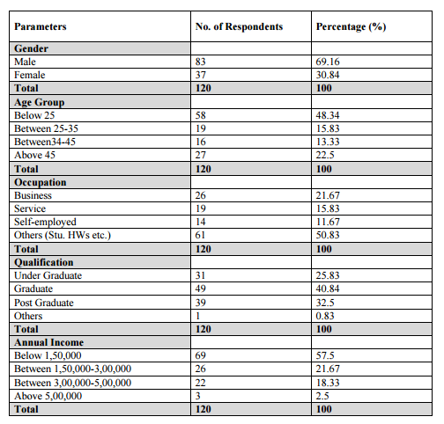

Slide 43
Contd.
They did survey on following Factors:-
Reliability-The bank provides reliable and error free services and assistance.
Responsiveness-The bank employees are always ready to help and consult the customers when need arises
Assurance-Customer’s confidence on the transactions and financial services provided by the bank
Empathy-Conveniency provided to the customer.
Tangible-Appearance of bank properties and employees
Based on the above factors the data gathered is as shown in next slide:-
(They gave the ratings out of 5)

Slide 44
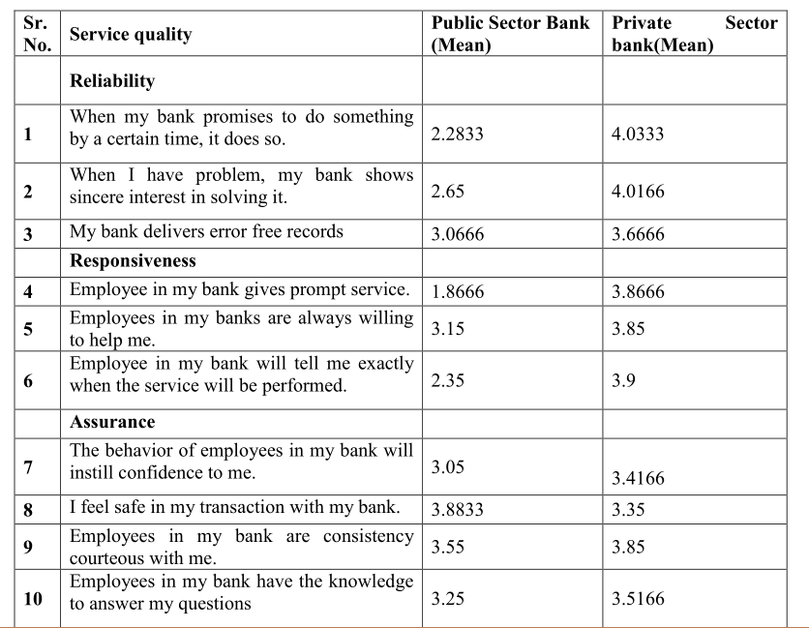

Slide 45

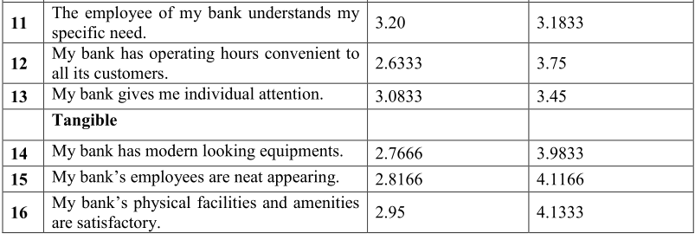

Slide 46
Inference
From this data we Infer that:-
A customer gives highest importance to reliability dimension.
Within this dimension they focuses more on how fulfillment of bank’s promise to work and their interest to do work.
Further customers give more second and third most importance to the responsiveness and assurance factors respectively.
So, the banks should give more focus on improving reliability, responsiveness and assurance factors, and give training to staffs according to that.
And at last we find that generally the customers are more satisfied from private banks though they charge more for their services.

Slide 47
Article analysis
How PSU banks lose out to private peers
Tamal Bandyopadhyay, live mint, E-paper, Mon, Jun 08 2015

Slide 48
Statistics provided in the article
•Among 39 listed banks in India—both private and public—four recorded net losses in the March quarter, and three of them are public sector banks.
• They are Bank of India, Oriental Bank of Commerce and Punjab and Sind Bank.
• At least nine other public banks recorded a drop in net profit compared with the year-ago quarter; and for a few of them, the drop has been pretty sharp.

Slide 49
Statistics provided in the article
• For instance, Punjab National Bank (PNB) posted a 62% drop in net profit; for Dena Bank, United Bank of India (UBI) and Indian Overseas Bank (IOB), the drop in net profit was even sharper—between 70% and 87%.
• Two private banks that posted a drop in the March-quarter net profit are Jammu and Kashmir Bank Ltd and South Indian Bank Ltd.

Slide 50
Reason for the drop in net profits
•The sole reason for the losses and the drop in net profits is ballooning bad assets, for which banks need to set aside money.
• Fourteen Indian banks now have at least 5% or more gross bad loans and, barring two, all are public sector banks.
• UBI’s gross bad loans are 9.49% of loan assets and those of IOB, 8.33%.
• Similarly, the seven banks that have between 4% and 5% bad assets are all public sector banks.
• Of the five banks that have 3-4% gross bad assets, four are from the public sector.

Slide 51
•ICICI Bank Ltd is the lone private sector entry into this segment. After setting aside money for such loans, 13 banks have at least 3% or more net non-performing assets (or NPAs) and barring one, all are from the public sector.
•Provisions on account of bad assets have eaten into their net profit, even though not too many banks have shown a drop in their operating profit.
• For instance, PNB’s provision for bad loans rose 161% in the March quarter over the December quarter—from Rs.1,468 crore to Rs.3,834 crore; for Punjab and Sind Bank, the rise has been 150% and for Syndicate Bank, 146%. Among others, IDBI Bank Ltd.'s provision rose 80%, that of Bank of Baroda 44%, and Bank of India 43%.

Slide 52
“Separating the men from the boys.”
•Analysis by Ashwin Ramarathinam and Ravindra Sonavane from Mint’s research wing which focused on 14 listed private banks and 25 listed public sector banks.
•In almost every parameter, private banks are doing better than their peers in the public sector and their market share has been growing.
•In fiscal year 2014, private banks’ operating profit was almost flat, but in 2015, it rose 19%.
• In contrast, public sector banks’ operating profit dropped close to 6% in 2014 and rose about 8% in 2015.

Slide 53
•After setting aside money for bad loans, private banks’ net profit rose 17.66% in 2014, while in 2015, the growth was 18.11%.
•Public banks’ net profits dropped a little more than 26% in 2014 and just about 1% in 2015.
•Public banks’ gross NPAs grew close to 25% in 2015 after surging 37% in the previous year, while gross NPA growth for private banks was 30% and 15% in those two years respectively, albeit on a lower base.
• Post provisions, net NPAs of public banks grew 42% in 2014 and 26% in 2015. The comparable figures for private banks are 45% and 43%—again on a relatively smaller base.

Slide 54
•What is more interesting to note is that public sector banks are lagging behind private banks both in deposits and advances growth.
• In 2015, public sector banks’ business growth has been almost half that of private banks.
• For instance, public banks’ deposit growth has been 9.13%, against private banks’ 16.16%; similarly, private banks’ advances grew close to 19%, compared to 8.13% for public banks.

Slide 55
The outcome
•As a result, private banks’ market share has been growing steadily.
• In the past two years, their share in operating profit has grown from 29.13% to 32.59%, while that of net profit has jumped from close to 35% to more than 50.5%, even as their deposits and advances continue to remain one-fifth of public sector banks’ despite steady growth.
• Public sector banks’ market share of deposits in the past two years has slipped from 81.82% to 80.92%, and that of loan advances from 80.72% to 78.72%.

Slide 56
•In other words, with roughly one-fifth of market share in bank deposits and advances, private banks account for more than half the net profit of the industry.
• This is possible because their market share of gross NPAs is a shade less than 10% and net NPAs around 7%. Incidentally, the 14 listed private banks’ total net profit is about 25% more than their gross bad assets, while the 25 listed public sector banks’ gross bad assets are almost seven-and-a-half times their net profit.

Slide 57
Thank you

